Slide 1
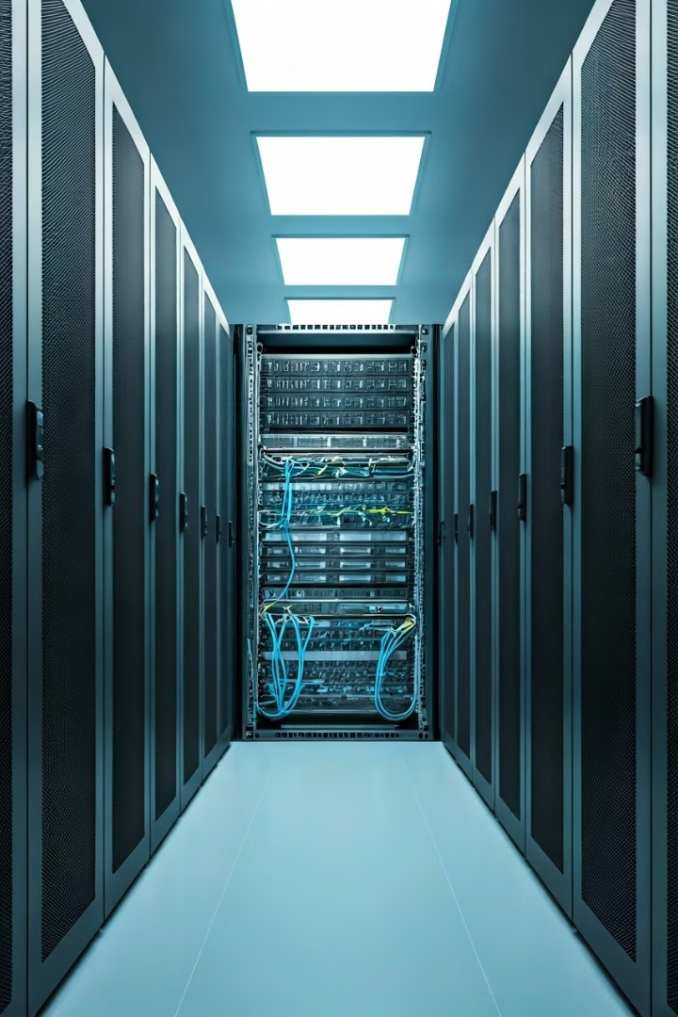
Introduction to Parameter Devices
Parameter devices are crucial components of network security infrastructure. These devices act as the first line of defense against cyber threats, safeguarding networks and their valuable data. Parameter devices can be categorized into various types, each specializing in different aspects of security.

Slide 2
Intrusion Detection System (IDS)
An Intrusion Detection System (IDS) is a software or hardware-based security tool that monitors network traffic for malicious activity. It analyzes patterns and behaviors that deviate from normal network operations, identifying potential threats and generating alerts. IDSs are passive, meaning they do not actively block or prevent intrusions, but rather report suspicious activity to security personnel.
1
Passive Monitoring
2
Threat Detection
IDSs function as passive observers, analyzing network traffic without directly interfering with data flow.
By comparing network traffic against known attack patterns and signatures, IDSs identify potential threats and generate alerts for security teams.
3
Alerting and Reporting
4
Example Scenarios
When an IDS detects a potential intrusion, it triggers alerts that inform security personnel, enabling them to investigate and respond accordingly.
An IDS might detect a denial-of-service attack, a brute force attempt to guess passwords, or an attempt to exploit known vulnerabilities in network systems.
Nilesh.Panchal@nfsu.ac.in

Slide 3
Intrusion Prevention System (IPS)
An Intrusion Prevention System (IPS) takes a more proactive approach to network security compared to an IDS. It not only monitors network traffic for suspicious activity but also actively blocks or prevents identified threats from reaching their target systems. IPSs work by analyzing traffic patterns and using predefined rules to filter and block malicious activity.
Active Protection
Rule-Based Filtering
Threat Mitigation
Unlike IDSs, IPSs actively intervene in network traffic, blocking identified threats in real time.
IPSs use predefined rules to identify and block malicious traffic, effectively acting as a security gatekeeper.
By preventing threats from reaching their targets, IPSs play a critical role in protecting networks from damage and downtime.
Nilesh.Panchal@nfsu.ac.in

Slide 4




Firewall Fundamentals
A firewall is a security system that controls network traffic between a private network and the external world. It acts as a gatekeeper, allowing only authorized traffic to pass through while blocking unauthorized access. Firewalls work by examining network traffic based on predefined rules, allowing or denying connections based on specific criteria.
Packet Filtering
Rule-Based Decision Making
Security Enforcement
Firewalls analyze incoming and outgoing network packets, examining their source and destination addresses, ports, and protocols.
Based on predefined rules, the firewall decides whether to allow or block each packet, effectively acting as a gatekeeper for network traffic.
By blocking unauthorized traffic and allowing only permitted connections, firewalls protect networks from unauthorized access and malicious activity.
Nilesh.Panchal@nfsu.ac.in

Slide 5
Types of Firewalls
Firewalls come in various forms, each with its own strengths and applications. Understanding these different types allows organizations to choose the most suitable solution for their specific security needs.
Packet Filtering Firewalls
Stateful Inspection Firewalls
These basic firewalls analyze network packets based on predefined rules, allowing or blocking traffic based on source and destination addresses, ports, and protocols.
Stateful inspection firewalls go beyond simple packet filtering by examining the context and state of network connections, offering more granular control and security.
Application-Level Firewalls
Next-Generation Firewalls (NGFWs)
These firewalls focus on inspecting application-specific traffic, such as web traffic, ensuring security at a deeper level beyond basic network protocols.
NGFWs offer comprehensive security features beyond traditional firewalls, including intrusion prevention, malware detection, and advanced threat analysis.
Nilesh.Panchal@nfsu.ac.in

Slide 6




Network Operations Center (NOC)
A Network Operations Center (NOC) is a dedicated facility responsible for monitoring and managing the network infrastructure of an organization. NOC engineers use sophisticated monitoring tools and systems to track network performance, identify and resolve issues, and ensure network availability and security. NOCs play a critical role in maintaining network uptime and minimizing disruptions.
Network Monitoring
Security Monitoring
Network Maintenance
Incident Response
NOC engineers constantly monitor network performance metrics, such as bandwidth usage, latency, and error rates, to identify potential issues.
NOCs actively monitor for security threats, such as intrusions, malware, and unauthorized access attempts, to protect network resources.
NOC engineers perform routine maintenance tasks, including software updates, hardware upgrades, and configuration changes, to ensure optimal network performance.
NOCs handle network incidents, such as outages, security breaches, and performance issues, providing timely resolution and minimizing impact on network operations.
Nilesh.Panchal@nfsu.ac.in

Slide 7

Security Operations Center (SOC)
A Security Operations Center (SOC) is a specialized team and facility responsible for monitoring, analyzing, and responding to cybersecurity threats. SOC analysts use sophisticated tools and techniques to detect, investigate, and mitigate security incidents, safeguarding an organization's IT infrastructure and data from malicious actors.
Focus
Cybersecurity Threats
Responsibilities
Threat detection, incident response, security analysis, and vulnerability management
Tools
SIEM systems, intrusion detection and prevention systems, security information gathering tools
Key Personnel
Security analysts, incident responders, security engineers

Slide 8
Security Information and Event Management (SIEM)
Security Information and Event Management (SIEM) is a comprehensive security solution that gathers, analyzes, and correlates security data from various sources within an organization's network. SIEM systems provide a unified view of security events, allowing security teams to identify potential threats, investigate incidents, and respond effectively.
Log Collection
1
SIEM systems collect security logs and events from various network devices, including firewalls, intrusion detection systems, servers, and endpoints.
2
Data Correlation
SIEM tools analyze and correlate security events from different sources, identifying patterns and relationships that might indicate malicious activity.
Threat Detection and Alerting
3
By analyzing correlated events, SIEM systems detect potential threats and generate alerts for security analysts to investigate and respond.
4
Incident Response
SIEM systems provide tools and information for security analysts to investigate incidents, analyze threat actors, and take appropriate actions to mitigate risks.
Nilesh.Panchal@nfsu.ac.in

Slide 9
Practical Example: Implementing a Firewall
Let's consider a practical scenario where a company implements a firewall to secure its internal network. The company has a small network of computers and servers that need to be protected from external threats. They decide to install a hardware-based firewall at the network boundary, connecting it to their internet gateway.
The firewall is configured with a set of rules that define which traffic is allowed to pass through and which is blocked. For example, they might allow web traffic from trusted sources but block access to certain websites known to host malicious content. They also configure the firewall to block unauthorized access to specific ports and services on their internal network.
This implementation provides a basic level of security for the company's network, preventing unauthorized access and protecting sensitive data. By carefully configuring the firewall and monitoring its logs for suspicious activity, the company can maintain a strong security posture and mitigate potential cyber threats.
Nilesh.Panchal@nfsu.ac.in

Slide 10

Key Takeaways
Parameter devices play a critical role in protecting networks from cyber threats, safeguarding valuable data and ensuring uninterrupted operations. By understanding the functionalities of different devices, such as IDSs, IPSs, and firewalls, organizations can effectively implement robust security measures.
Furthermore, tools like SIEM systems help centralize security monitoring and provide a comprehensive view of network events, enabling proactive threat detection and incident response. Implementing a secure network architecture that includes parameter devices and comprehensive security measures is essential in today's ever-evolving threat landscape.
Nilesh.Panchal@nfsu.ac.in

